Slide 1


SCHOLA
Online Class Management
A Single Platform to manage schedules and lecture materials for students
Notes:
Creadit picture : Unsplash Photo by Chris Yang
Link : https://unsplash.com/photos/1BtAeOohu1A Photo by Vidar Nordli-Mathisen
Link : https://unsplash.com/photos/xqMM3KoR7oI
1

Slide 2






SCHOLA
Team
Andromeda
Our team
Context
Objectives
Features
Technical Requirements
Timeline
ERD & SQL
Tasnim Ferdous
180041108
Sidratul Muntaha
180041118
Farhan Ishmam
180041120
2
Notes:
Creadit picture : Photo by Anthony Intraversato on Unsplash Link : https://unsplash.com/photos/vYRAP3yMa3I
2

Slide 3

SCHOLA
Our Team
Crisis in Pandemic!
Context
Objectives
Online classes in lockdown introduced a number of problems:
Finding the correct class time
Not receiving notices on quizzes and classes
Juggling multiple online platforms
Different groups receiving unrelated notices
Losing track of current lecture status and quiz syllabus
Features
Technical Requirements
Timeline
ERD & SQL
3
Notes:
Creadit picture : Photo by Ethan Haddox on Unsplash Link : https://unsplash.com/photos/jvUZkoh4Hhw
3

Slide 4

SCHOLA
Our Team
Objectives
Context
Provide a single platform for all academic activities
Class Schedule for students based on department, program, section and lab group
Allow Class Representatives and Faculties to manage and Send Notices to appropriate groups
Use a personalized Evaluation Sheet and To-do List
Role-based Online Access
Objectives
Features
Technical Requirements
Timeline
ERD & SQL
4

Slide 5
SCHOLA
Our Team
Personal lecture Evaluation Sheet
Context
To-do List
Objectives
Individual Class Schedule
Overall Features
Features
Class Test and Exam dates
Technical Requirements
Role Based User Access
Timeline
Notices
ERD & SQL
5
Notes:
5

Slide 6
SCHOLA
Operating System
Hardware
Our Team
Any OS (as it is a Web-Based Application)
Database Server
Website Hosting Server
Context
Objectives
Technical Requirements
Features
Language
Software
Technical Requirements
Java Script (JS)
Hyper Text Markup Language (HTML)
Cascading Style Sheet (CSS)
Structured Query Language (SQL)
Browser
IDE
MySQL
Firebase User Auth
Timeline
ERD & SQL
6
Notes:
Creadit picture :
Photo by Jordan on Unsplash Link : https://unsplash.com/photos/evtWtv0i-6E
6

Slide 7
Week 1
Week 2
Week 3
Week 4
Week 5
Week 6
Week 7
Week 8
Week 9
Week 10
Week 11
Week 12
SCHOLA
Problem Definition
Our Team
Requirement Analysis
Context
Data Gathering
User Interface Design
Objectives
Database Design
Features
Implementing Database
Technical Requirements
Develop UI Elements
Front End Prototype
Timeline
Back End Prototype
ERD & SQL
Adding Features
Data Entry
Testing and Debugging
Integration and Deployment
7
Notes:
7

Slide 8
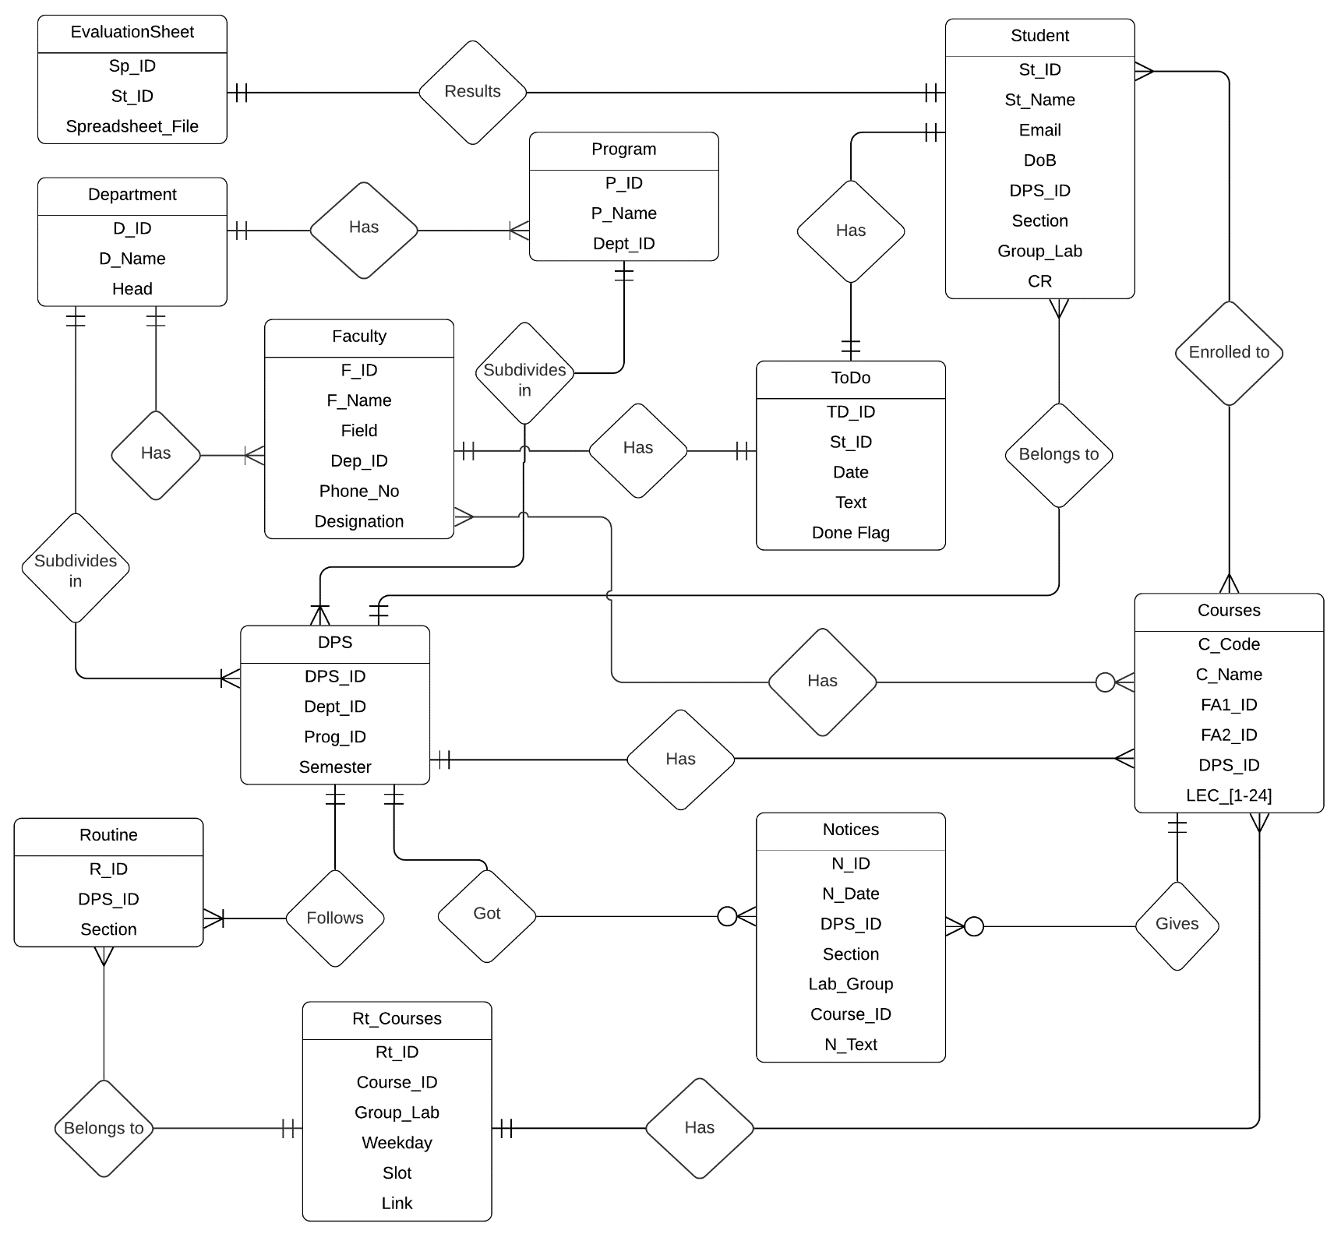
Entity Relationship Diagram
SCHOLA
Our Team
Context
Objectives
Features
Technical Requirements
Timeline
ERD & SQL
8

Slide 9
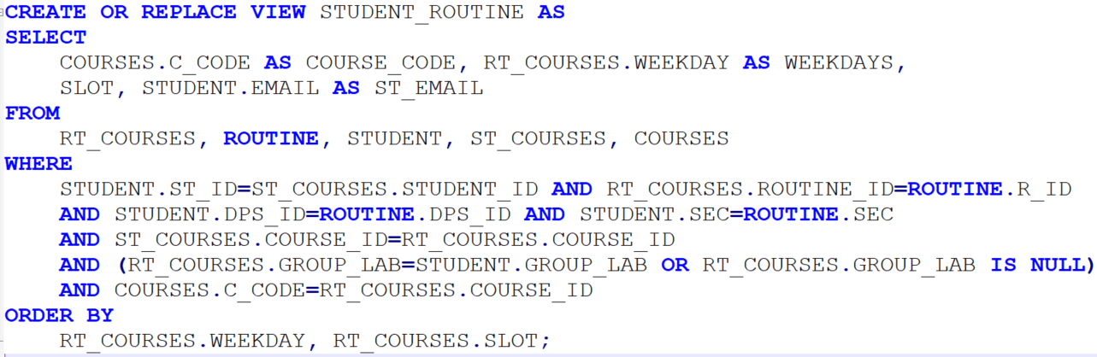
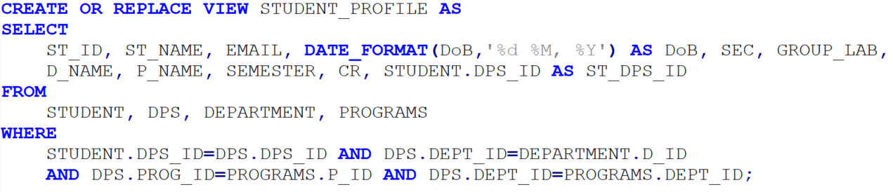
Student Routine View
SCHOLA
Our Team
Context
Objectives
Features
Technical Requirements
Student Profile View
Timeline
ERD & SQL
ERD & SQL
9

Slide 10
THANK
YOU
Notes:
10

